Slide 1
Logic
Lecture 2

Slide 2
Limitation of Propositional Logic
Propositional logic: the world is described in terms of elementary propositions and their logical combinations
Elementary statements:
Typically refer to objects, their properties and relations.
But these are not explicitly represented in the propositional logic
Hasan is a GUB student
Hasan - object
A GUB student - a property
Objects and properties are hidden in the statement, it is not possible to reason about them

Slide 3
Limitation of Propositional Logic
Statements that must be repeated for many objects
Example
If Hasan is a CSE GUB graduate then Hasan has passed CSE101
Translation
Hasan is a CSE GUB graduate → Hasan has passed CSE101
Solution: make statements with variables
If x is a CSE GUB graduate then x has passed CSE101
x a CSE GUB graduate → x has passed CSE101

Slide 4
Limitation of Propositional Logic
Statements that define the property of the group of objects
Example
Some of the CSE graduates graduate with honors.
Solution: make statements with quantifiers
- Universal quantifier –the property is satisfied by all members of the group
– Existential quantifier – at least one member of the group satisfy the property

Slide 5
Predicate Logic
Remedies the limitations of the propositional logic
• Explicitly models objects and their properties
• Allows to make statements with variables and quantify them
Basic building blocks of the predicate logic:
• Constant –models a specific object
Examples: “Hasan”, “Khulna”, “7”
• Variable – represents object of specific type
(defined by the universe of discourse)
Examples: x, y
(universe of discourse can be people, students, numbers)
• Predicate - Represents properties of objects
Examples: Red(car23), student(x), married(John,Ann)

Slide 6
Assigning value to Predicate
Predicate - Represents properties of objects
A predicate P(x) assigns a value true or false to each x depending
on whether the property holds or not for x.
x is a prime number (universe of discourse is integers)
What are the truth values of:
• P(2) T
• P(3) T
• P(4) F
• P(5) T
All statements P(2), P(3), P(4), P(5) are propositions.
Is P(x) a proposition? No. Many substitutions are possible.

Slide 7
Assigning value to Predicate
Predicates can have more arguments which represent the
relations between objects
Example:
• Let Q(x,y) denote ‘x+5 >y’
– Is Q(x,y) a proposition? No!
– Is Q(3,7) a proposition? Yes
– What is the truth value of:
– Q(3,7) T
– Q(1,6) F
- Q(3,y) may be T or F. not a proposition.

Slide 8
Predicate is not proposition
Important:
• statement P(x) is not a proposition since there are many objects it can be applied to
This is the same as in propositional logic …
… But the difference is:
• predicate logic allows us to explicitly manipulate and substitute for the objects
• Predicate logic permits quantified sentences where variables are substituted for statements about the group of objects

Slide 9
Quantified Statements
Predicate logic lets us to make statements about groups of objects
• To do this we use special quantified expressions
Two types of quantified statements:
• universal
Example: ‘ all CSE GUB graduates have to pass CSE 101”
– the statement is true for all graduates
• existential
Example: ‘Some CSE GUB students graduate with honor.’
– the statement is true for some people

Slide 10

Universal Quantifier
Defn: The universal quantification of P(x) is the proposition:
"P(x) is true for all values of x in the domain of discourse."
The notation denotes the universal quantification of P(x), and is expressed as for every x, P(x).
Example:
• Let P(x) denote x > x - 1.
• What is the truth value of ?
• Assume the universe of discourse of x is all real numbers.
• Answer: Since every number x is greater than itself minus 1.
Therefore, is true.

Slide 11
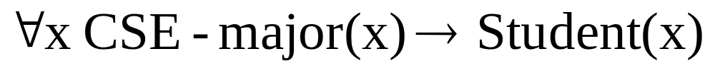
Universally Quantified Statement
Predicate logic lets us make statements about groups of objects
Universally quantified statement
• CSE-major(x) → Student(x)
– Translation: “if x is a CSE-major then x is a student”
– Proposition: no.
•
– Translation: “(For all people it holds that) if a person is a
CSE-major then s/he is a student.”
– Proposition: yes.

Slide 12
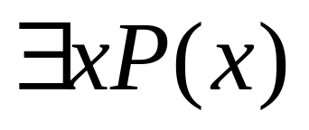
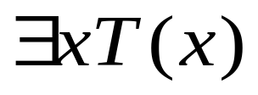
Existential Quantifier
Definition: The existential quantification of P(x) is the
proposition
"There exists an element in the domain (universe) of
discourse such that P(x) is true."
The notation:
Example 1:
• Let T(x) denote x > 5 and x is from Real numbers.
• What is the truth value of ?
• Answer:
• Since 10 > 5 is true. Therefore, it is true that

Slide 13
Quantified statements
Statements about groups of objects
Example:
• CSE-GUB-graduate (x) ˄ Honor-student(x)
– Translation: “x is a CSE-GUB-graduate and x is an honor student”
– Proposition: no.
•
– Translation: “There is a person who is a CSE-GUB-graduate and who is also an honor student.”
– Proposition: ? yes

Slide 14
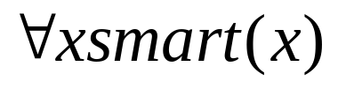
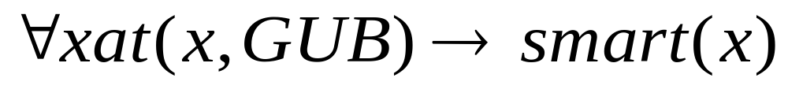
Translation with Quantifier
Sentence:
• All GUB students are smart.
• Assume: the domain of discourse of x are GUB students
• Translation:
• Assume: the universe of discourse are students (all students):
•
• Assume: the universe of discourse are people:
•

Slide 15
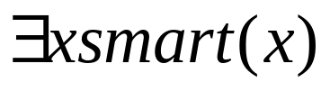
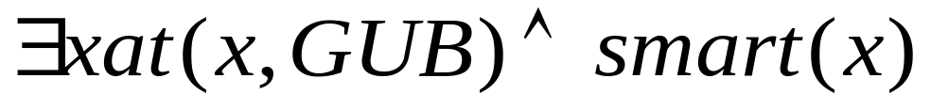
Translation with Quantifier
Sentence:
• Someone at GUB is smart.
• Assume: the domain of discourse are all GUB affiliates
• Translation:
• Assume: the universe of discourse are people:
•

Slide 16
Translation with Quantifier
Assume the following statement
Every student in this class has studied calculus
Consider the domain is the set of all people.
“For every person x, if person x is a student in this class then x has studied calculus.”
C(x) = x has studied calculus.
S(x) = Person x is in this class.
Can be written as ∀x(S(x) → C(x)).
Can not written as ∀x(S(x) ∧ C(x)). WHY?

Slide 17
Translation with Quantifier
Assume the following statements
“Some student in this class has visited Mexico”
Consider the domain is the set of all people.
There is a person x having the properties that x is a student in this class and x has visited Mexico.”
M(x) = x has visited Mexico
S(x) = Person x is in this class.
Can be written as ∃x(S(x) ∧ M(x)
- Can not written as ∃x(S(x) → M(x)). WHY?

Slide 18
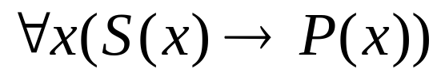
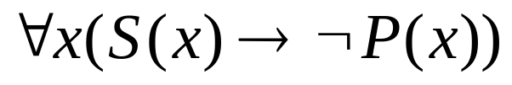
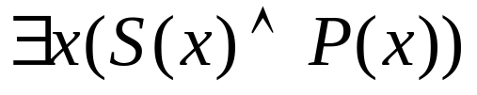
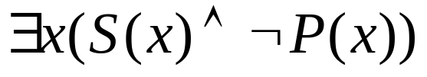
Translation with Quantifier
Assume two predicates S(x) and P(x)
Universal statements typically tie with implications
• All S(x) is P(x)
–
• All S(x) is not P(x)
–
Existential statements typically tie with conjunctions
• Some S(x) is P(x)
–
• Some S(x) is not P(x)
–

Slide 19
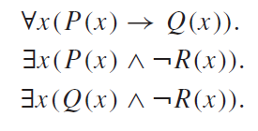
Translation with Quantifier
Exercise
Consider the following statements.
“All lions are fierce.”
“Some lions do not drink coffee.”
“Some fierce creatures do not drink coffee.”
Let,
P(x) = x is a lion
Q(x) = x is fierce
R(x) = x drinks coffee

Slide 20
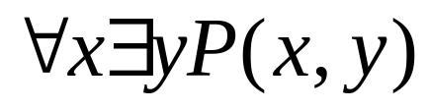
Nested Quantifier
More than one quantifier may be necessary to capture the
meaning of a statement in the predicate logic.
Example:
• Every real number has its corresponding negative.
• Translation:
– Assume:
• a real number is denoted as x and its negative as y
• A predicate P(x,y) denotes: “x + y =0”
• Then we can write:

Slide 21
Nested Quantifier
Translate the following statement
∀x(C(x) ∨ ∃y(C(y) ∧ F(x, y)))
C(x) = x has a computer
F(x, y) = x and y are friends
The domain for both x and y consists of all students in your school.
For every student x in your school, x has a computer or there
is a student y such that y has a computer and x and y are friends.
In other words, every student in your school has a computer or has a friend who has a computer.

Slide 22
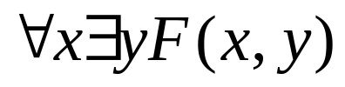
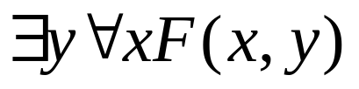
Order of Quantifier
The order of nested quantifiers matters if quantifiers are of different type
Example:
• Assume F(x,y) denotes “x is a friend of y”
• Then:
• Translates to: Everybody is a friend of somebody.
• And:
• Translates to: There is someone who is friend of everyone.
The meaning of the two is different.

Slide 23
Order of Quantifier
Suppose that x and y are assigned values. Then, there exists a real number z such that x + y = z.
Consequently, the quantification
∀x∀y∃z Q(x, y, z)
For all real numbers x and for all real numbers y there is a real number z such that x + y = z.
∃z∀x∀y Q(x, y, z),
There is a real number z such that for all real numbers x and for all real numbers y it is true that x + y = z.
The meaning of the two is different.

Slide 24
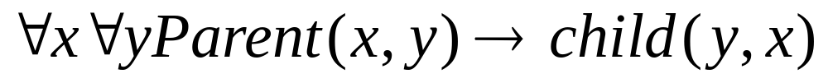
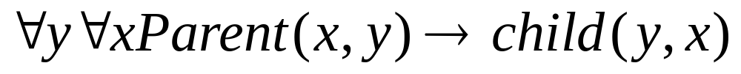
Order of Quantifier
The order of nested quantifiers does not matter if quantifiers are of the same type
Example:
• For all x and y, if x is a parent of y then y is a child of x
• Assume:
– Parent(x,y) denotes “x is a parent of y”
– Child(x,y) denotes “x is a child of y”
• Two equivalent ways to represent the statement:

Slide 25




Negation of quantifiers
English statement:
• Nothing is perfect.
• Translation:
Another way to express the same meaning:
• Everything is imperfect.
• Translation:
Conclusion: is equivalent to

Slide 26


Negation of quantifiers
DeMorgan Laws for quantifiers
Negation | Equivalent

Slide 27
Rules of Inference
Rules of inference: logically valid inference patterns
Modus Ponens, or the Law of Detachment
• Rules of inference
p
p → q
q
• Given p is true and the implication p → q is true then q is true.

Slide 28
Rules of Inference
Addition
p → (p˅q)
p
p ˅ q
Simplification
p˄q →p
p˄q
p

Slide 29
Rules of Inference
Modus Tollens
[¬q ˄ (p → q)] → ¬p
Hypothetical Syllogism
[(p → q) ˄ (q → r)] → (p → r)
Disjunctive Syllogism
[(p ˅ q) ˄ ¬p] → q
Logical Equivalence
p <=> q
p→q is a tautology
DeMorgans law
¬( p ˅ q ) <=> ¬p ˄ ¬q

Slide 30
Applying rule of Inference
Text:
(1) It is not sunny this afternoon and it is colder than yesterday.
(2) We will go swimming only if it is sunny.
(3) If we do not go swimming then we will take a canoe trip.
(4) If we take a canoe trip, then we will be home by sunset.
Propositions:
p = It is sunny this afternoon,
q = it is colder than yesterday,
r = We will go swimming ,
s= we will take a canoe trip
t= We will be home by sunset

Slide 31
Applying rule of Inference
Propositions:
p = It is sunny this afternoon,
q = it is colder than yesterday,
r = We will go swimming ,
s= we will take a canoe trip
t= We will be home by sunset
Translation:
¬ p ˄ q,
r → p,
¬ r → s,
s → t
We want to show: t
(1) It is not sunny this afternoon and it is colder than yesterday.
(2) We will go swimming only if it is sunny.
(3) If we do not go swimming then we will take a canoe trip.
(4) If we take a canoe trip, then we will be home by sunset.

Slide 32
Applying rule of Inference
Proof:
1. ¬ p ˄ q Hypothesis
2. ¬ p Simplification
3. r → p Hypothesis
4. ¬ r Modus tollens (step 2 and 3)
5. ¬ r → s Hypothesis
6. s Modus ponens (steps 4 and 5)
7. s → t Hypothesis
8. t Modus ponens (steps 6 and 7)
end of proof

Slide 33
Thank You

